Slide 1
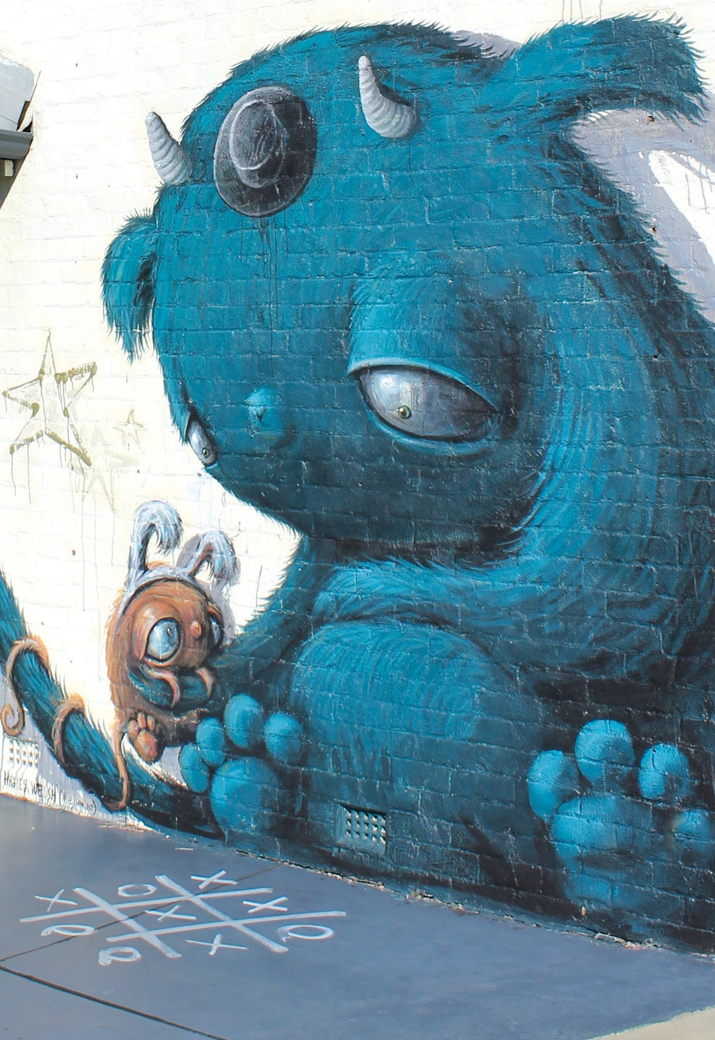
Highlights from the Annual Report
2019/2020

Slide 2
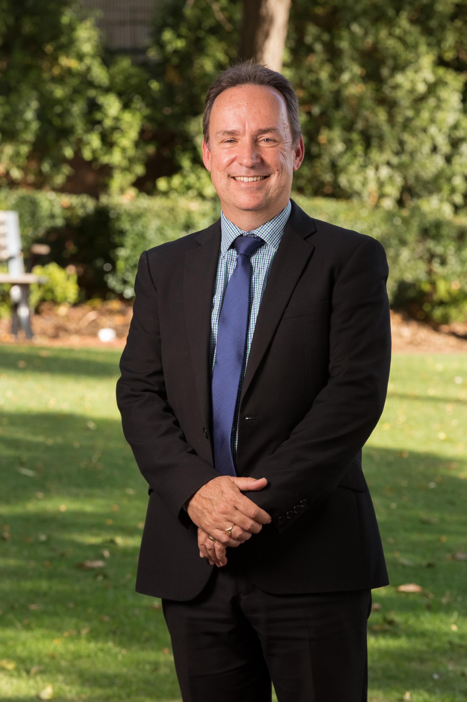

Office of the CEO

Slide 3

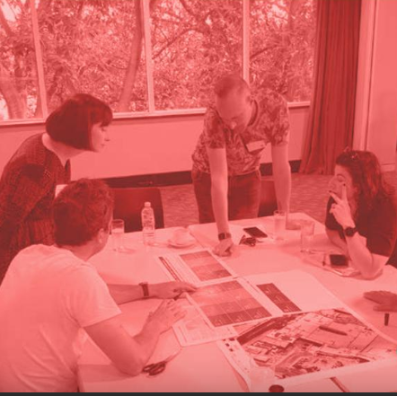
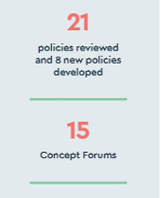
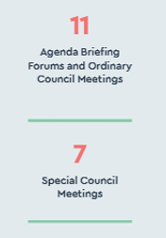
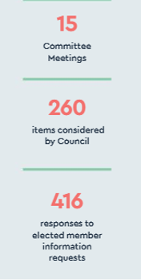
#LOVEVICPARK | VICTORIAPARK.WA.GOV.AU

Slide 4


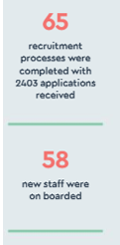
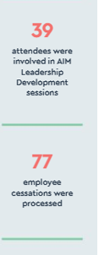
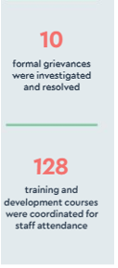
#LOVEVICPARK | VICTORIAPARK.WA.GOV.AU

Slide 5

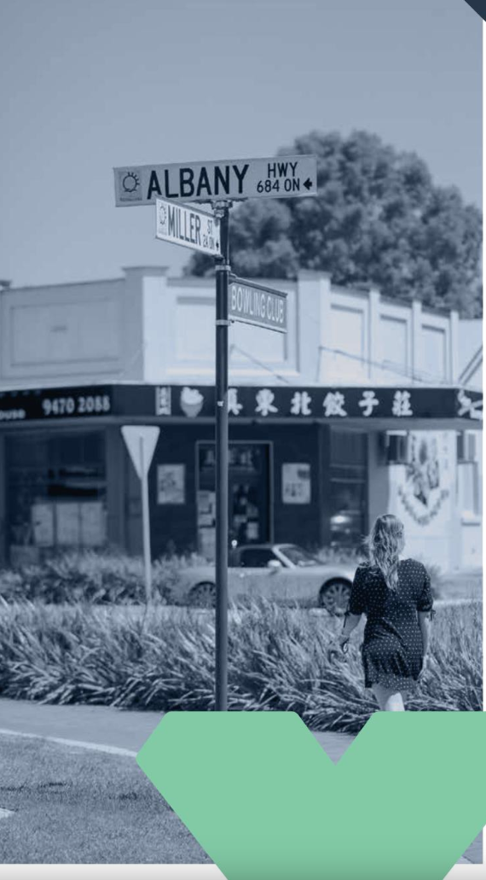
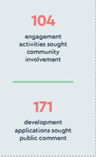
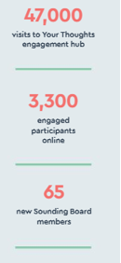
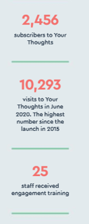

Slide 6


Slide 7

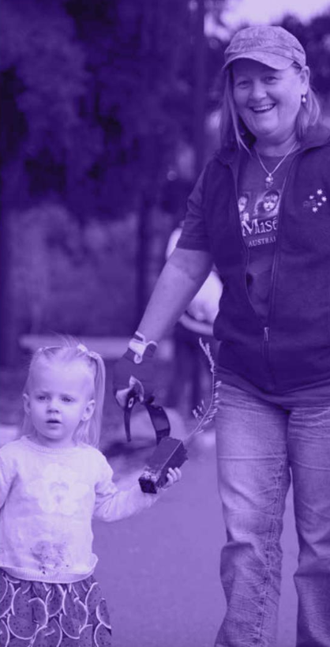
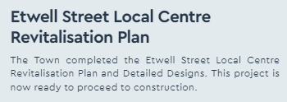
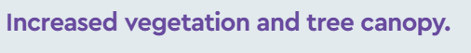
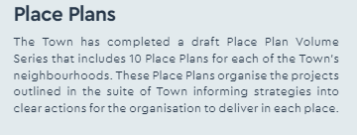
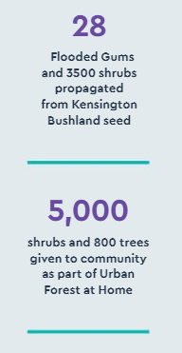
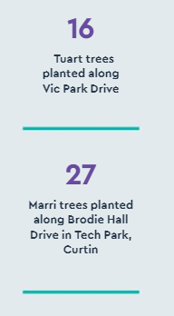
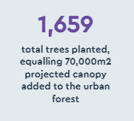
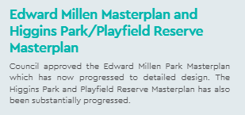

Slide 8

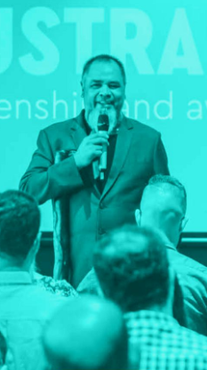
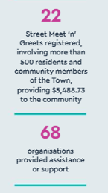
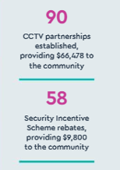
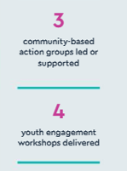
#LOVEVICPARK | VICTORIAPARK.WA.GOV.AU

Slide 9

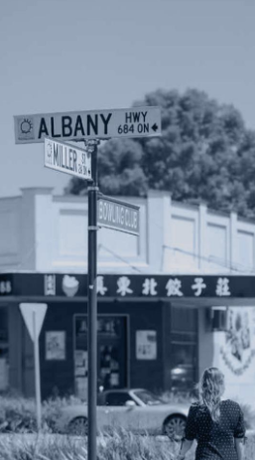

#LOVEVICPARK | VICTORIAPARK.WA.GOV.AU
Notes:
Business events – disruptor breakfast and 2nd annual business awards
Ed campaigns – encouraging shop local: Destination WA and Our State on a Plate

Slide 10
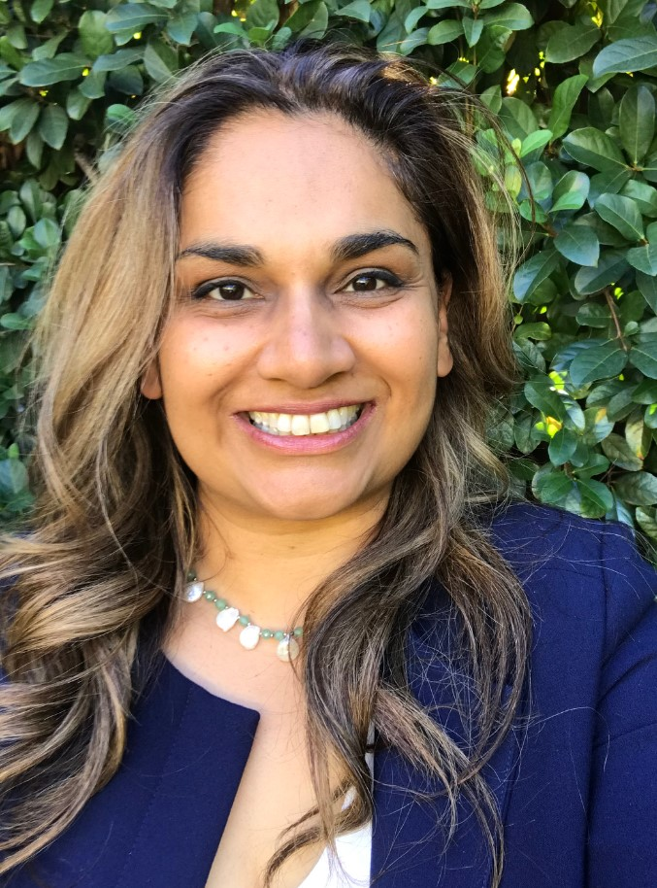
Operations
Office

Slide 11
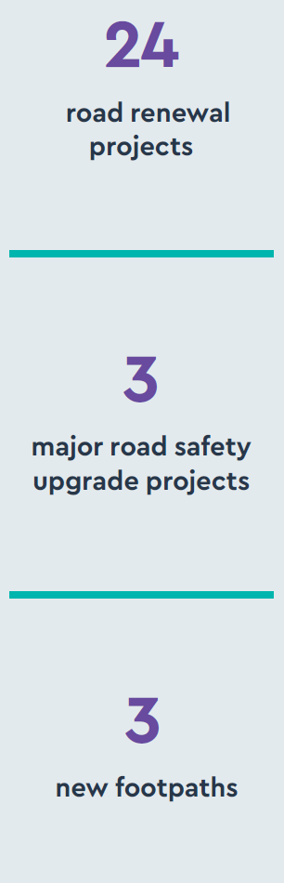

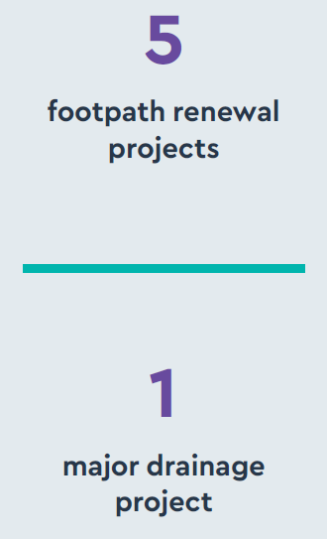
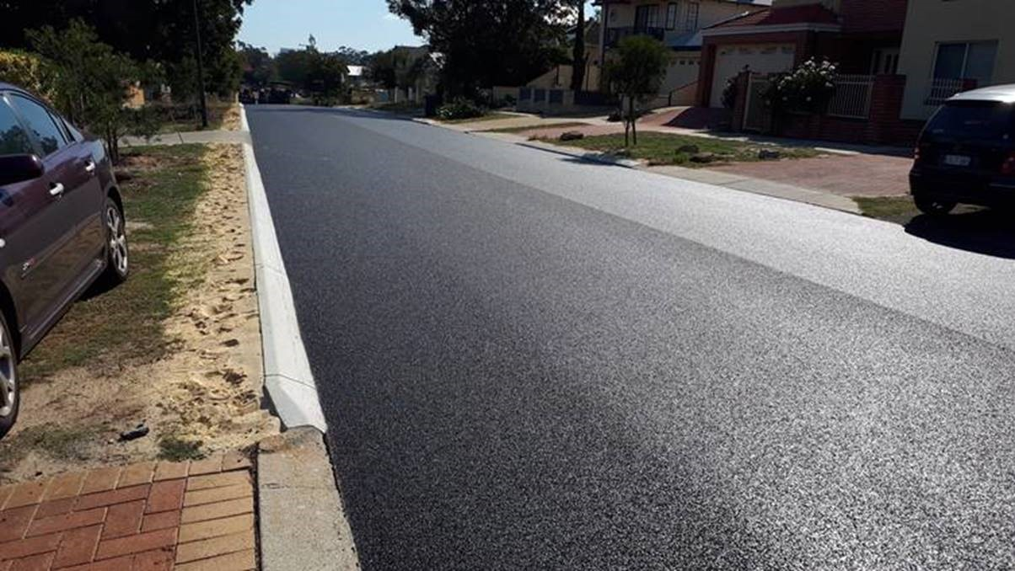
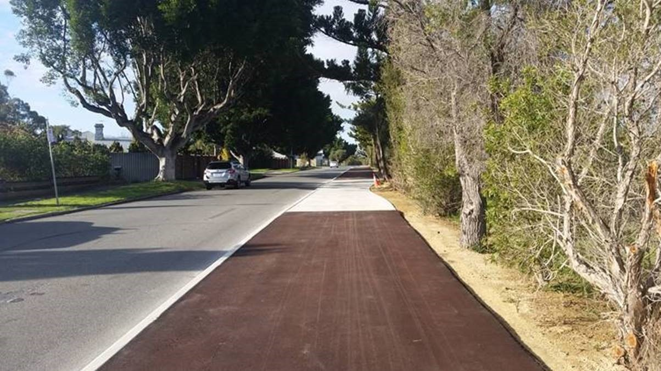
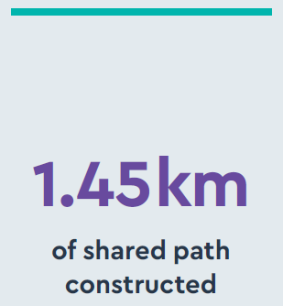
Operations
#LOVEVICPARK | VICTORIAPARK.WA.GOV.AU
Notes:
BE: Breakfast with Ben Wyatt, Drinks with the Expoerts, VP Business Awards, sundownder
BT: How to starte a food business, ID dats
EDC: Eat Ride Enjoy, Xmas in the Park, Feed the Fans

Slide 12
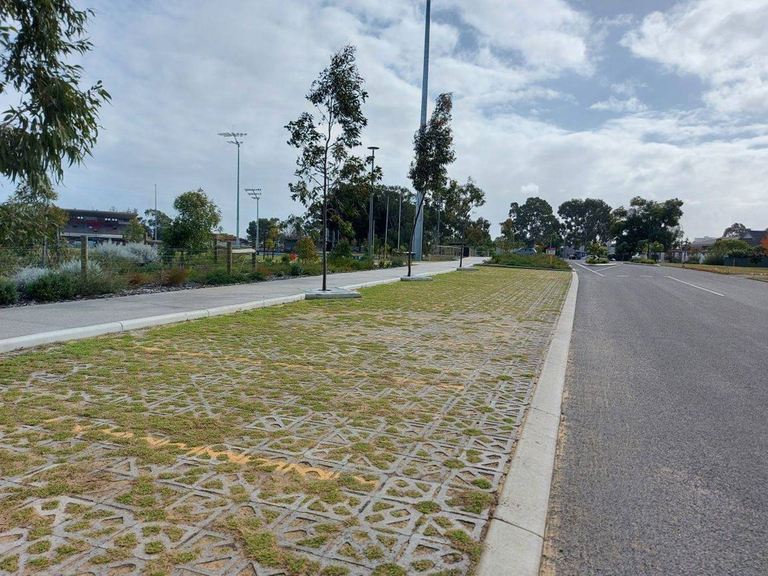
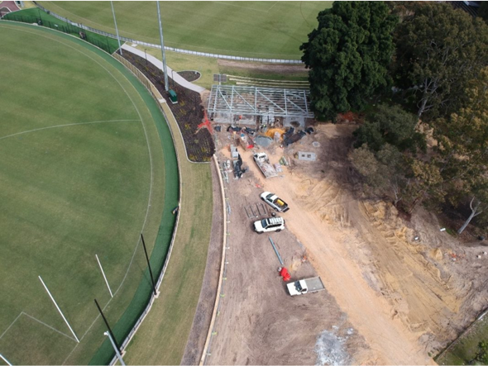
Lathlain Zone 2x
#LOVEVICPARK | VICTORIAPARK.WA.GOV.AU
Notes:
BE: Breakfast with Ben Wyatt, Drinks with the Expoerts, VP Business Awards, sundownder
BT: How to starte a food business, ID dats
EDC: Eat Ride Enjoy, Xmas in the Park, Feed the Fans

Slide 13
Property Development & Leasing
KEY HIGHLIGHTS
The creation of a new service area was undertaken.
Temple Street rezoning
Grace period
Updates to Leasing Policies
Woolworths deal
Higgins Tennis Club facility
Edward Millen Adaptive Heritage and Landscape Redevelopment.
#LOVEVICPARK | VICTORIAPARK.WA.GOV.AU
Notes:
BE: Breakfast with Ben Wyatt, Drinks with the Expoerts, VP Business Awards, sundownder
BT: How to starte a food business, ID dats
EDC: Eat Ride Enjoy, Xmas in the Park, Feed the Fans

Slide 14
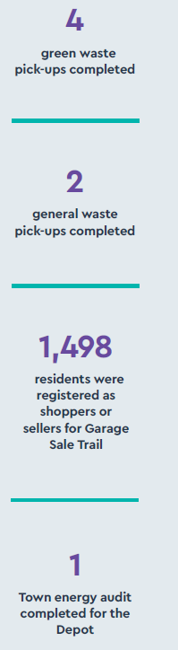

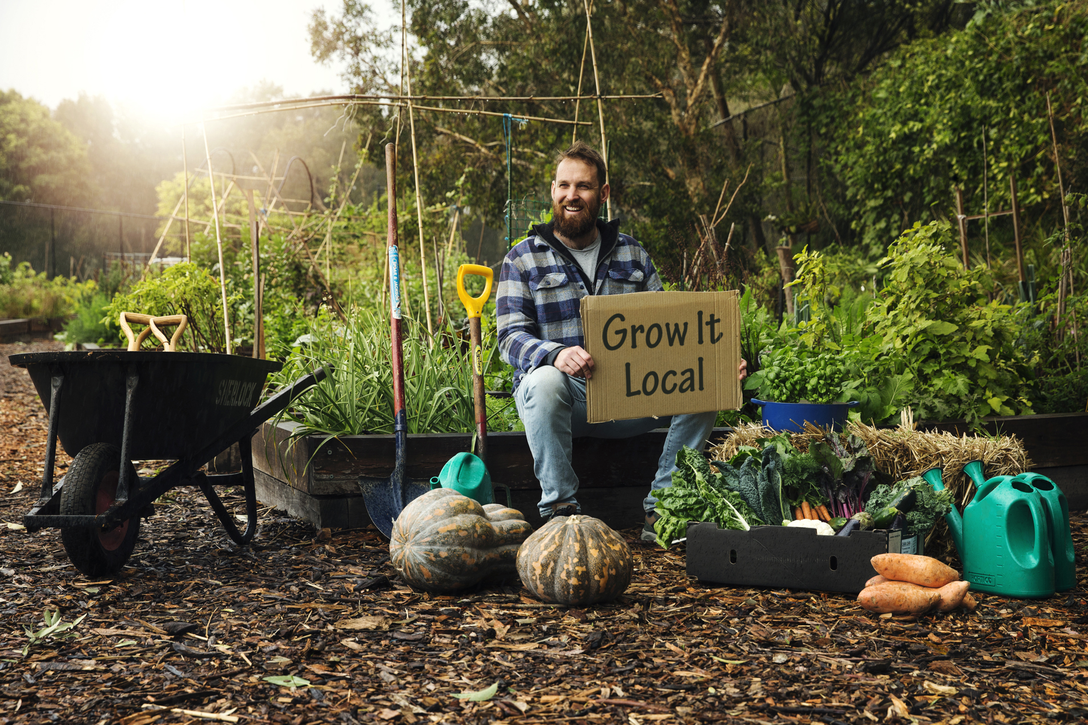
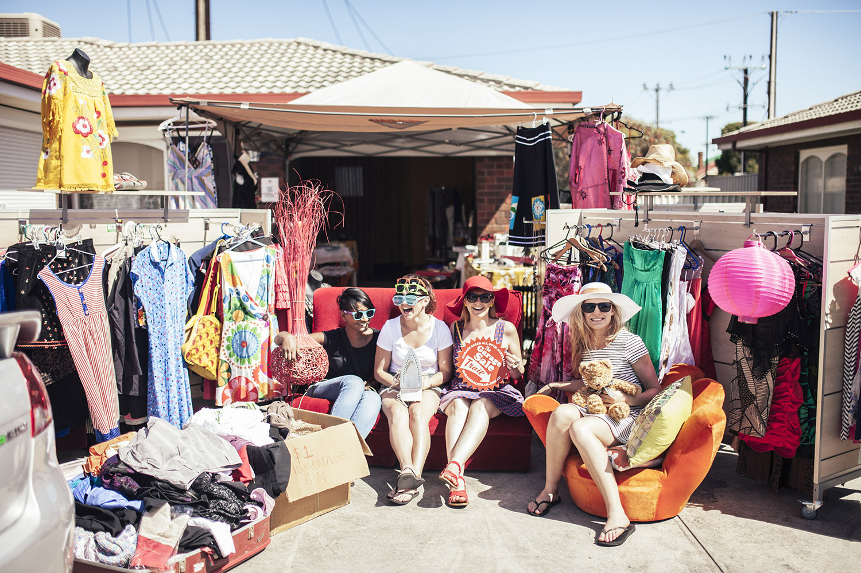
Environmental Education Initiatives
#LOVEVICPARK | VICTORIAPARK.WA.GOV.AU
Notes:
BE: Breakfast with Ben Wyatt, Drinks with the Expoerts, VP Business Awards, sundownder
BT: How to starte a food business, ID dats
EDC: Eat Ride Enjoy, Xmas in the Park, Feed the Fans

Slide 15
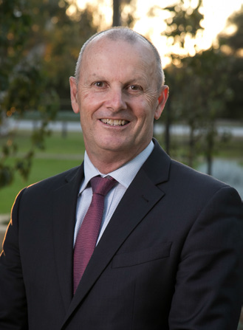
Finance Office

Slide 16
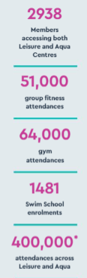


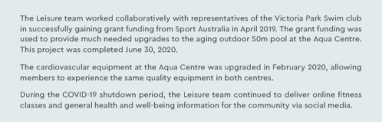
#LOVEVICPARK | VICTORIAPARK.WA.GOV.AU
Notes:
Community Perception Survey: Civic events: Citizenship, Remembrance, Oz, Anzac and Mayoral
13 public events: skill building Success Series workshops for local businesses and community groups, Summer Street Party Dec, 3 free Twilight Trio community concerts in December, January and February
Large public bookings: 4WD show, Perth Garden Festival, Equestrian in the Park

Slide 17

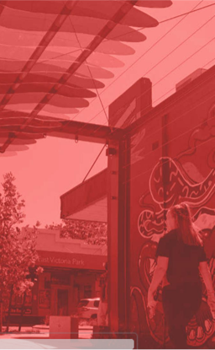
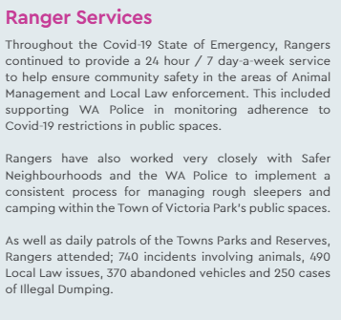
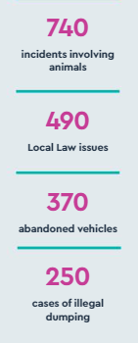
#LOVEVICPARK | VICTORIAPARK.WA.GOV.AU
Notes:
BE: Breakfast with Ben Wyatt, Drinks with the Expoerts, VP Business Awards, sundownder
BT: How to starte a food business, ID dats
EDC: Eat Ride Enjoy, Xmas in the Park, Feed the Fans

Slide 18


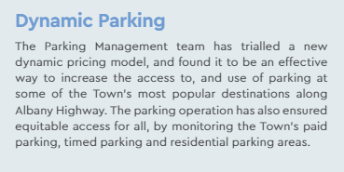
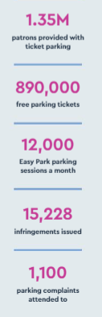
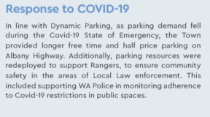
#LOVEVICPARK | VICTORIAPARK.WA.GOV.AU
Notes:
BE: Breakfast with Ben Wyatt, Drinks with the Expoerts, VP Business Awards, sundownder
BT: How to starte a food business, ID dats
EDC: Eat Ride Enjoy, Xmas in the Park, Feed the Fans

Slide 19


